Slide 3
Since displacement and amplitude are results of the oscillation of a vertical Spring mass system, therefore they cannot be the factors affecting the time period of this system. The dependence or independence of T on other factors is checked by performing several experiments whose observations are tabulated below :

Slide 5
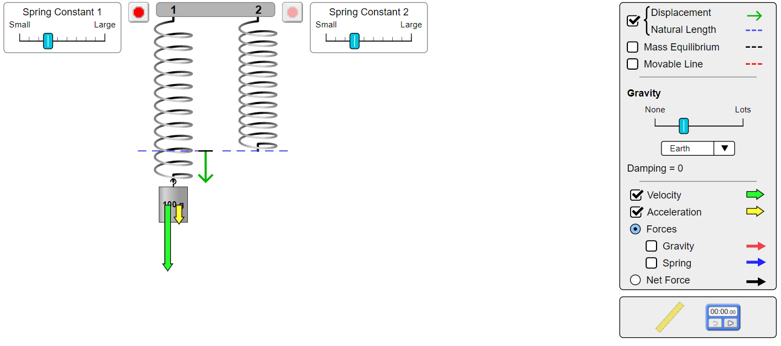
a) When the mass is just released :

Slide 6
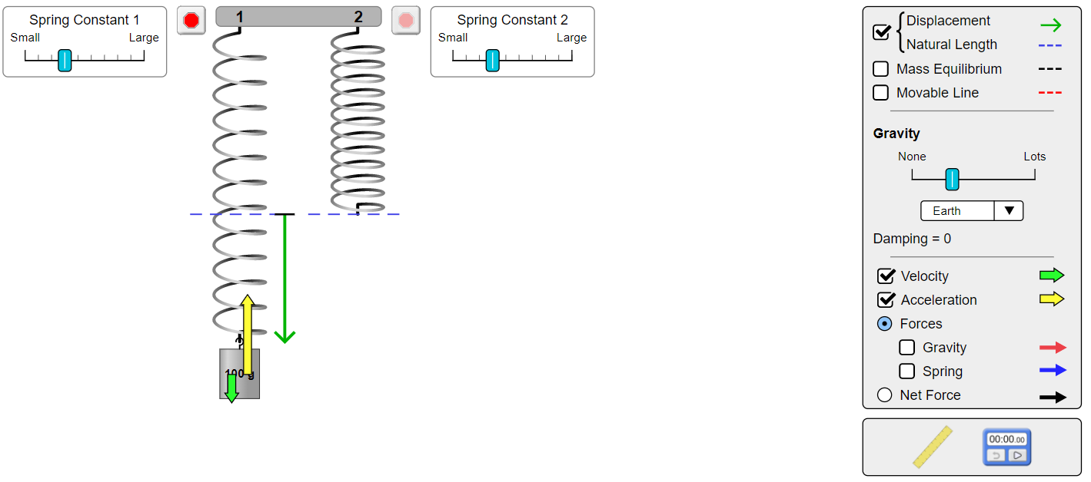
b) When the mass is moving downward :

Slide 7
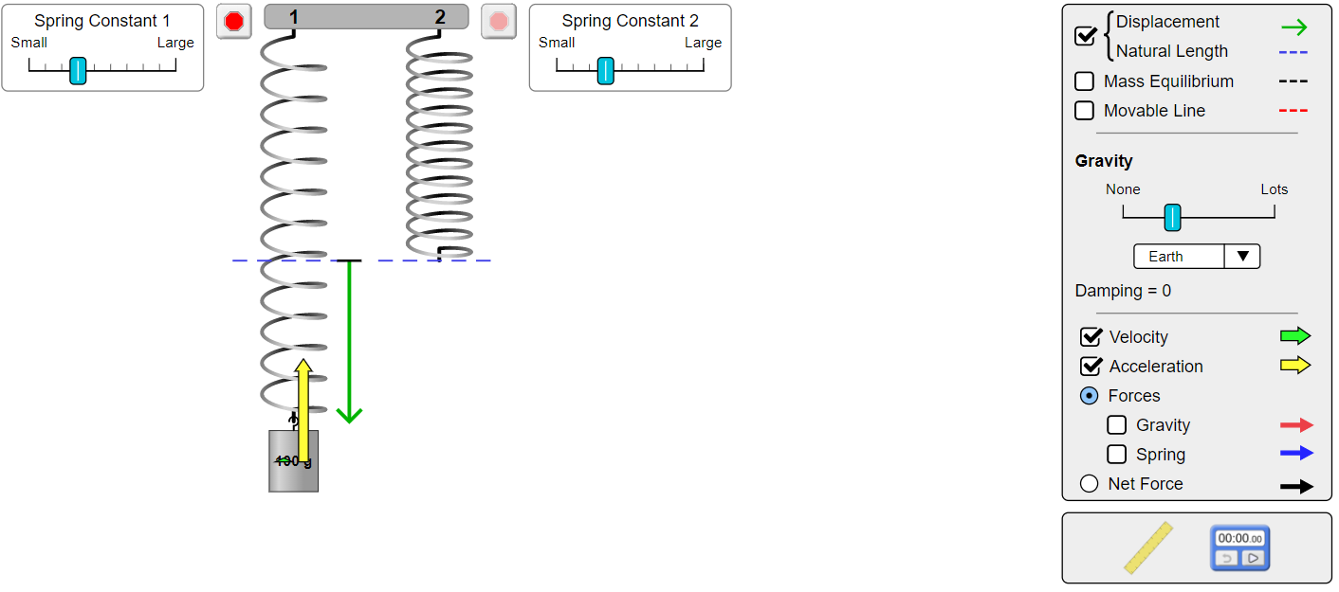
c) When the mass is at bottommost extreme position :

Slide 8
d) When the mass is moving upward from the extreme position to the equilibrium position :

Slide 10
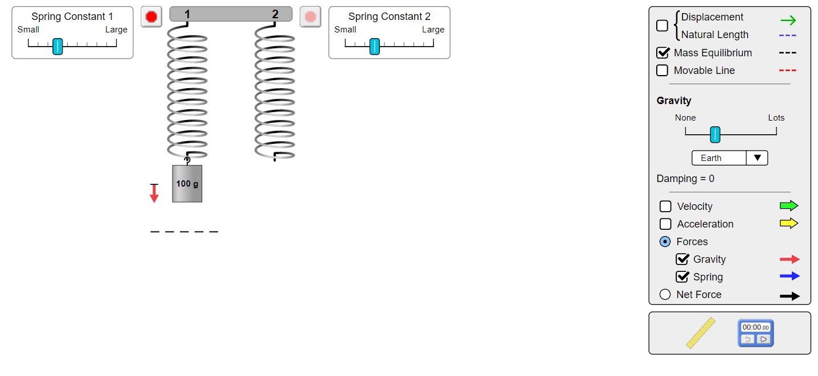
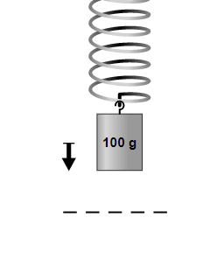
4)
a) At the instant when the mass is just released :
The net force on the mass :

Slide 11
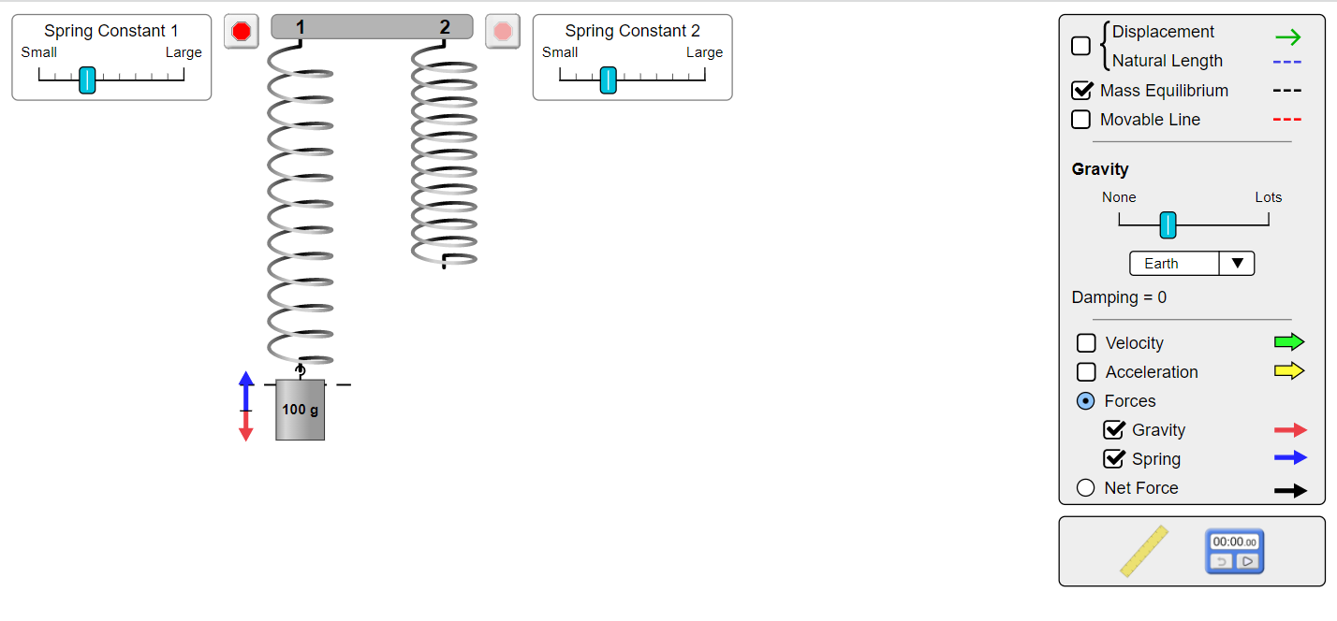
b) While the block is moving downwards :
The net force on the mass :

Slide 12
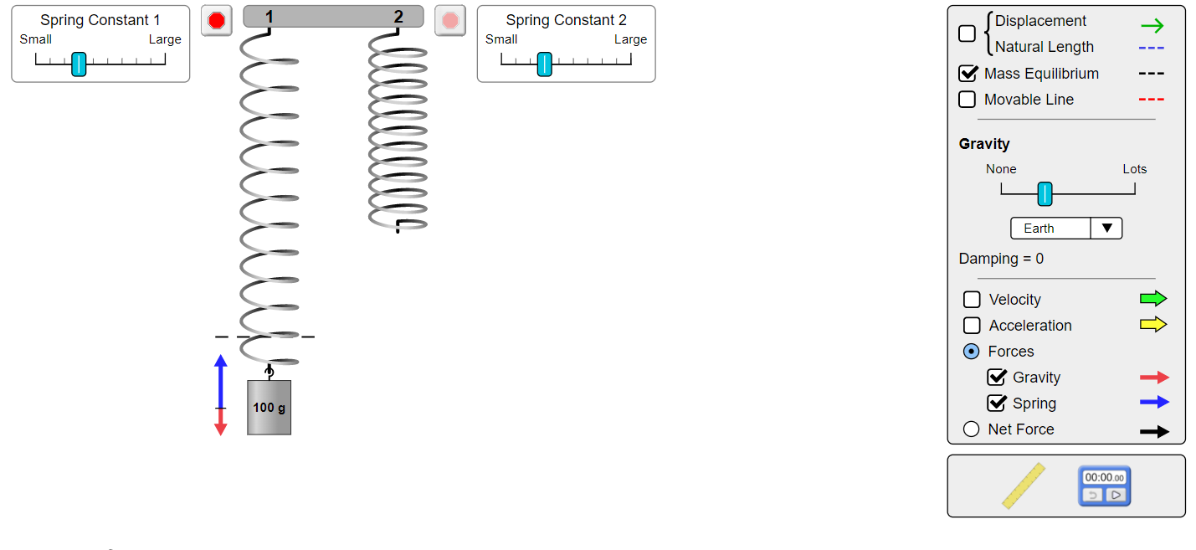
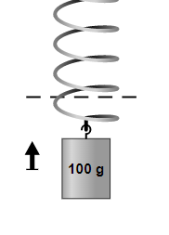
c) When the mass is at the bottommost extreme position :
The net force on the mass :

